Slide 1
Noise Pollution: Stress Response of Shore Crabs
By: T Lloyd, E Audia, D Delaat & A Margolis

Slide 2
Background
Hairy Shore Crab (Hemigrapsus oregonensis) under threat from European Green Crab (Carcinus maenas) (Jensen et. al 2002)
Seattle’s rapid urban growth is driving a major surge in marine construction and waterfront infrastructure (Wilson et. al 2015)
Anthropogenic sounds negatively affect marine animals (Carlos M. Duarte et al. 2021)
There is little research on marine invertebrates' response and tolerance to noise pollution (Birch et. al 2025)
Shipping noise can drive up oxygen consumption in C. maenas (Birch et. al 2025)

Slide 3
How does anthropogenic noise pollution, specifically coastal construction, affect the stress response of Hemigrapsus oregonensis?

Slide 4
Hypothesis
Ha: Anthropogenic noise pollution has a significant effect on the physiological stress response of shore crabs.
Ho: Anthropogenic noise pollution has no effect on the physiological stress response of shore crabs.

Slide 5
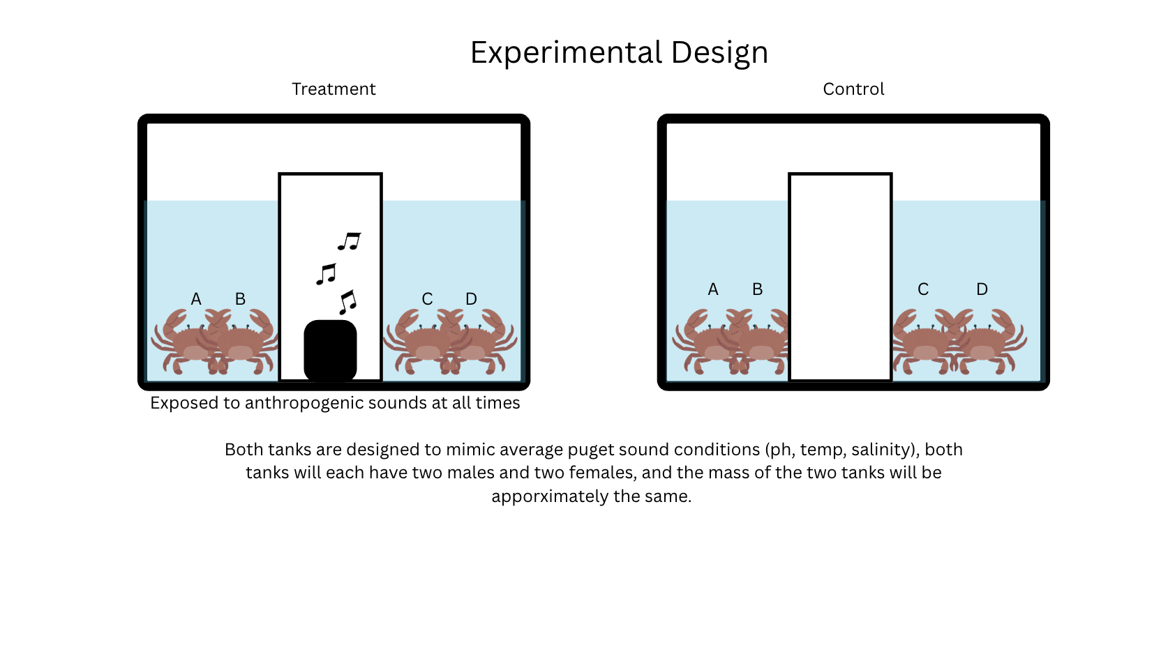

Slide 6
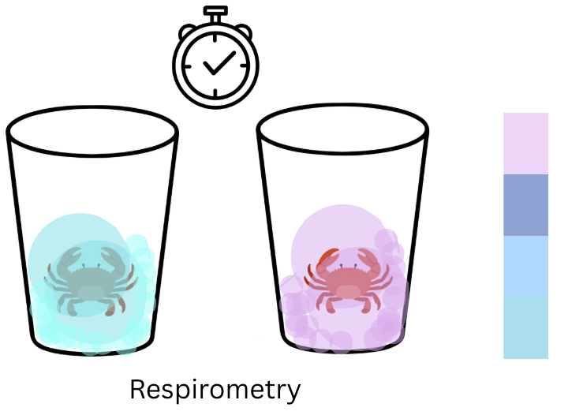
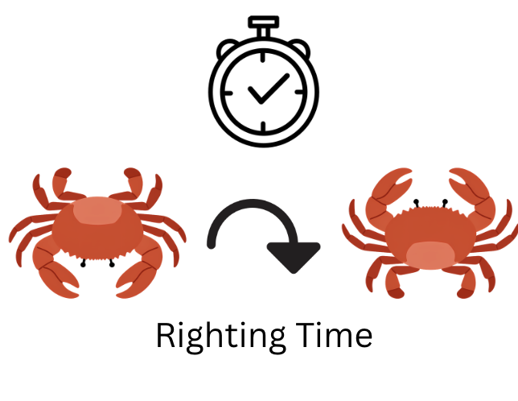
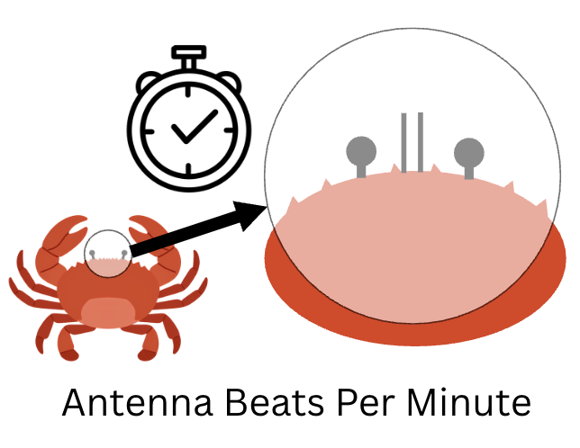
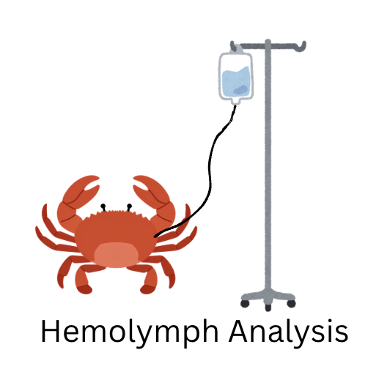
Data Collection
Independent Variable:
Sound exposure
Dependent Variables (stress indicators):​
Antenna beats per minute
Respirometry
Righting time
Hemolymph osmolarity (osmoregulation)
Confounding Variables:
Distance from speaker
Feeding status
Researcher disturbance
Size/molt stage
Parasitic infection

Slide 7
Design Choices
Constant noise exposure
Need to be able to monitor response after exposure for at least 8 hours
Best imitation of real-world environment
Single noise type
Various noise types may affect crabs differently
Changing songs/volume/pitch throughout may alter results
Continuous monitoring over experiment duration instead of weekly changes
Allows us to see if physiological stress worsens over time or if response is immediate

Slide 8
Literature Baselines
Established physiological norms for shore crabs at rest:
-Respiration rate: 1.5 - 2.5 μmol O₂ / g / h (Wale et al. 2013)
-Antenna beat rate: 40 - 80 beats / min (Literature Standard)
-Hemolymph osmolarity: 900 - 1050 mOsm/kg (Regional Baselines)
These values serve as our control benchmarks. Deviations in treatment crabs will indicate anthropogenic noise-induced physiological stress.

Slide 9
Data Application
How will our collected data help us answer our research question?
Comparing treatment group to control isolates effect of noise and will identify physiological stress response to anthropogenic noise
Application
Inform conservation efforts and guide future construction permitting
Study Limits
Time length
Longer term chronic response (crabs living on construction sites) unclear
Number of replicates

Slide 10
ANY QUESTIONS?

Slide 11
Works Cited
Jensen GC, McDonald PS, Armstrong DA (2002) East meets west: competitive interactions between green crab Carcinus maenas, and native and introduced shore crab Hemigrapsus spp.. Mar Ecol Prog Ser 225:251-262 https://doi.org/10.3354/meps225251
Peng C, Zhao X, Liu G. Noise in the Sea and Its Impacts on Marine Organisms. Int J Environ Res Public Health. 2015 Sep 30;12(10):12304-23. doi: 10.3390/ijerph121012304. PMID: 26437424; PMCID: PMC4626970.
Carlos M. Duarte et al., The soundscape of the Anthropocene ocean.Science371,eaba4658(2021).DOI:10.1126/science.aba4658
Birch A, Cox KD, Murchy KA, Emry S, Harley CDG. Shipping noise tolerance in invertebrates: A case study of the shore crab Hemigrapsus oregonensis. PLoS One. 2025 Aug 12;20(8):e0329098. doi: 10.1371/journal.pone.0329098. PMID: 40794759; PMCID: PMC12342237.
A. Meriwether W. Wilson, Robert Mugerauer, Terrie Klinger, Rethinking marine infrastructure policy and practice: Insights from three large-scale marina developments in Seattle, Marine Policy, Volume 53, 2015, Pages 67-82, ISSN 0308-597X, https://doi.org/10.1016/j.marpol.2014.11.020. (https://www.sciencedirect.com/science/article/pii/S0308597X14003212)

